Slide 1

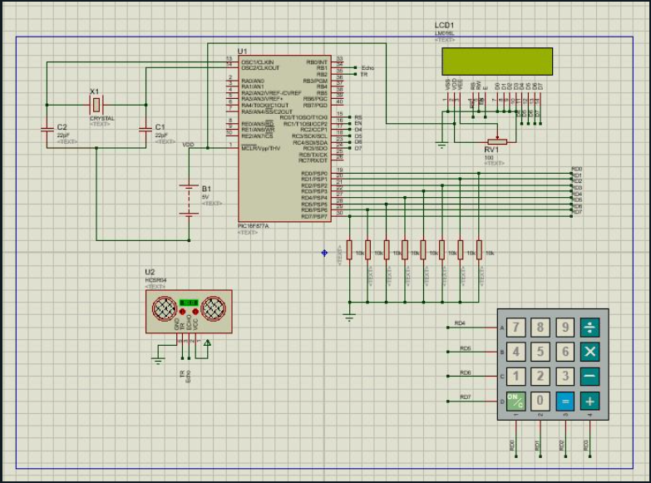
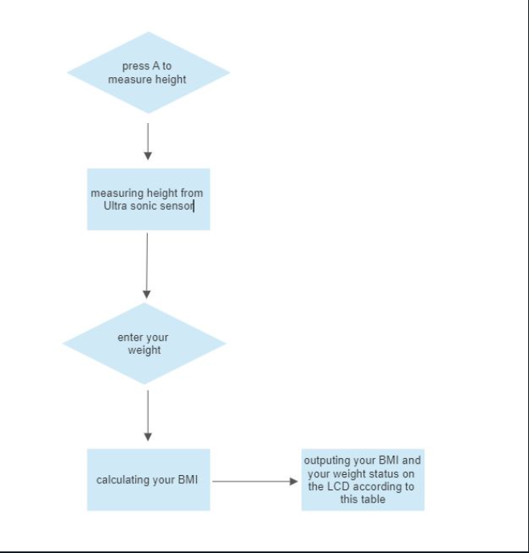
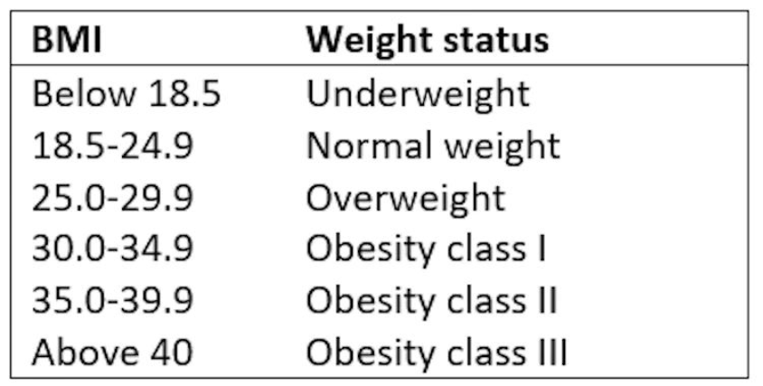
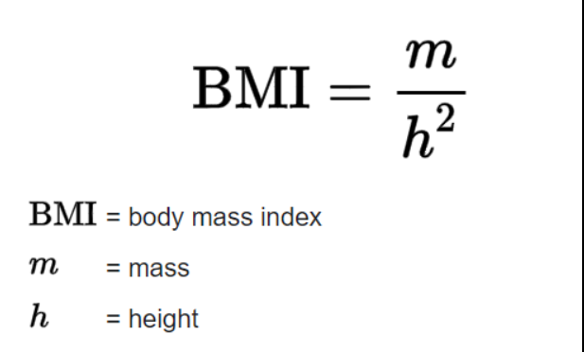
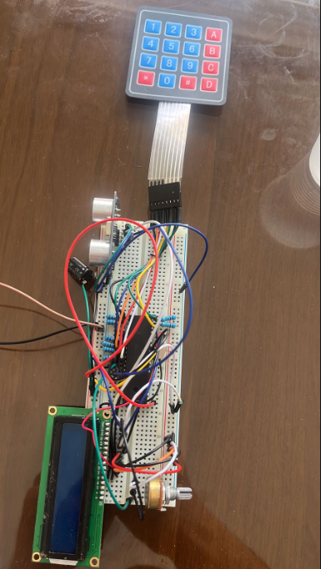
BMI(Body Mass Index)
M. Juha, M. Haddad, M. Batarseh
Supervisor: Dr. Belal Sababha
Embedded Systems Final Design Project, Fall 2022
King Abdullah II School of Engineering
Princess Sumaya University for Technology
Introduction
Embedded systems play a crucial role in various fields, including healthcare and fitness. Body Mass Index (BMI) is a widely used metric to assess an individual's body composition and overall health. This report presents the design and implementation of an embedded system that utilizes an ultrasonic sensor and a 4x4 keypad interfaced with a PIC 16F877A microcontroller to calculate a person's BMI representing it on a 16x2 LCD. The system aims to provide a convenient and easy method for individuals to monitor their BMI.
Result
After successfully managing to measure the height and reading the weight of the user, We are able to calculate the Body Mass Index according to following circuit. Thus giving the user an indication of their current health status.
Figure 4: circuit design of our system
Figure 3: Design of our system
Flow chart representing our software system
Figure 1: Flow chart
Figure 2: BMI table
Conclusion
Throughout the project, we faced various challenges. The most difficult challenge was the system resetting repeatedly, which required troubleshooting and debugging. Additionally, we were unable to find a suitable load cell within reach to measure human weight, Which posed a challenge in accurately calculating the BMI. To start overcoming these challenges, we provided recommendations, these recommendations include: the replacement of the keypad with a load cell capable of measuring human weight, thus improving the accuracy and functionality of the system.
In conclusion, this project showcases the design and implementation of a BMI using an ultrasonic sensor for measuring the height, and a 4x4 keypad to enter the weight and start the measuring process. With the BMI calculator we’re able to give the user an idea about their current health status and help them monitor their progress.

